Slide 1



Slide 2
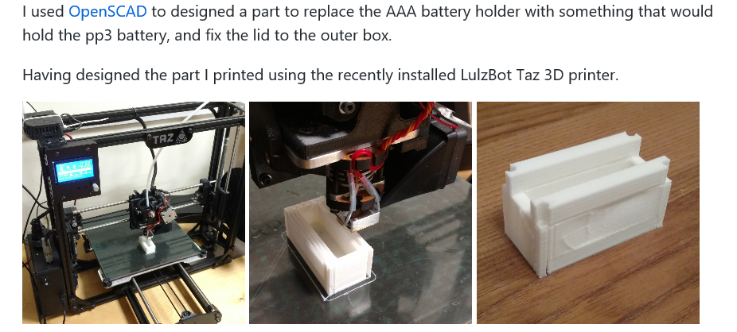
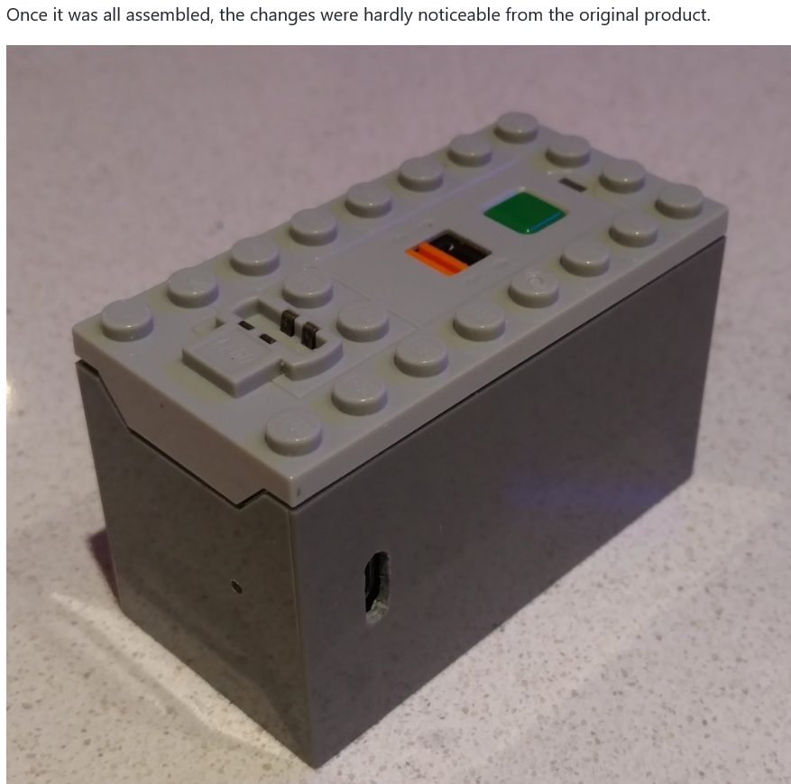
Member Project…
Lego AAA battery box conversion to Li-ion
The LEGO Power Functions AAA Battery Box (88000) is used to power my kids' train set. The problem with this battery box is that it takes 6 AAA batteries, and only runs for about an hour or so on a set. Lego have a rechargeable Li-ion battery box, but if costs over £40, and another £25 for the AC adapter.

Slide 3


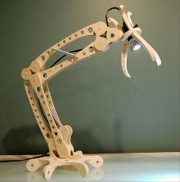
Project Suggestion…
Laser cut Items

Slide 4
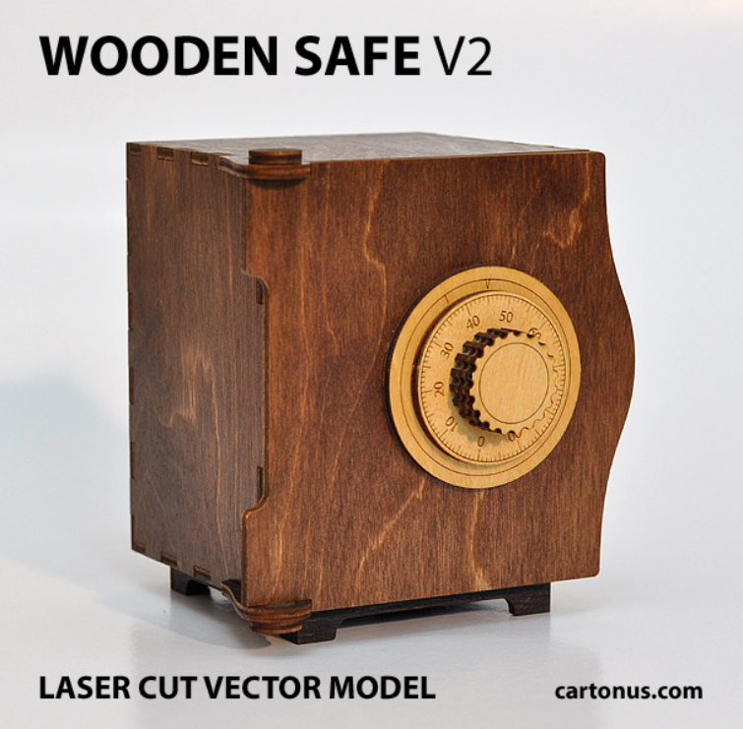
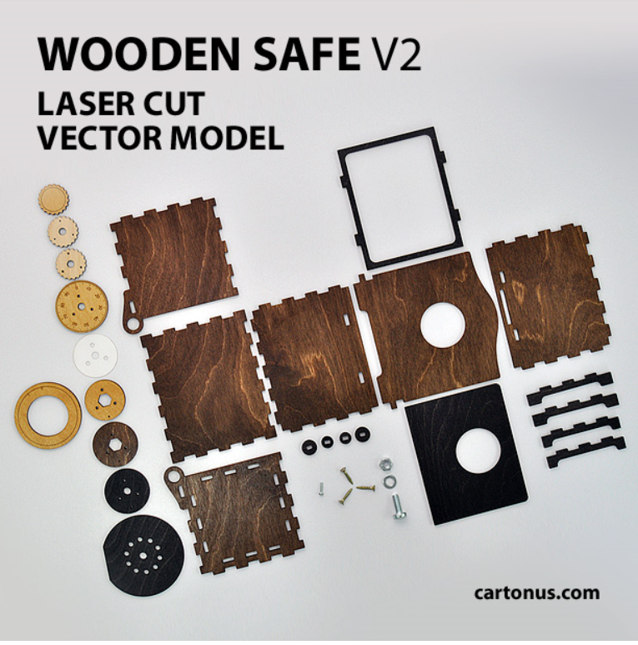
Project Suggestion…

Slide 5

Project Suggestion…

Slide 6

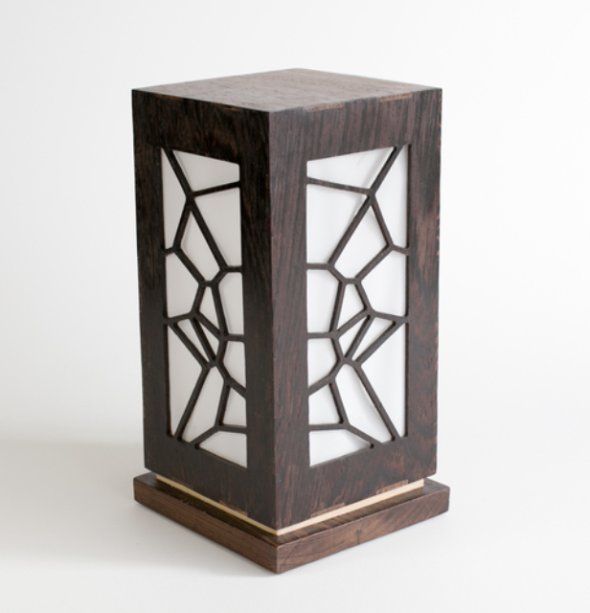
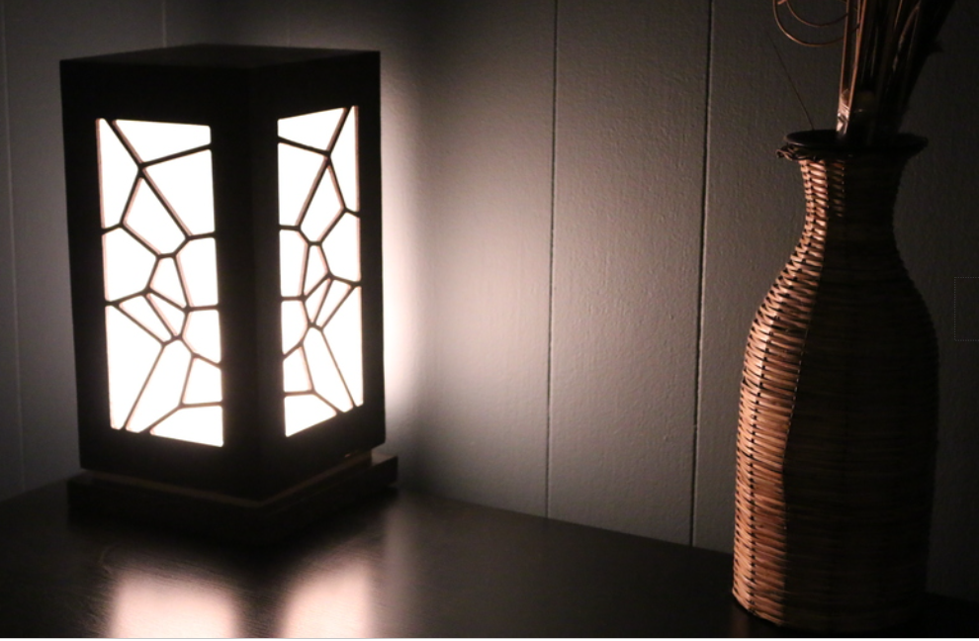
Project Suggestion…

Slide 7
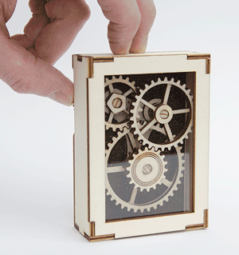
Project Suggestion…

Slide 8

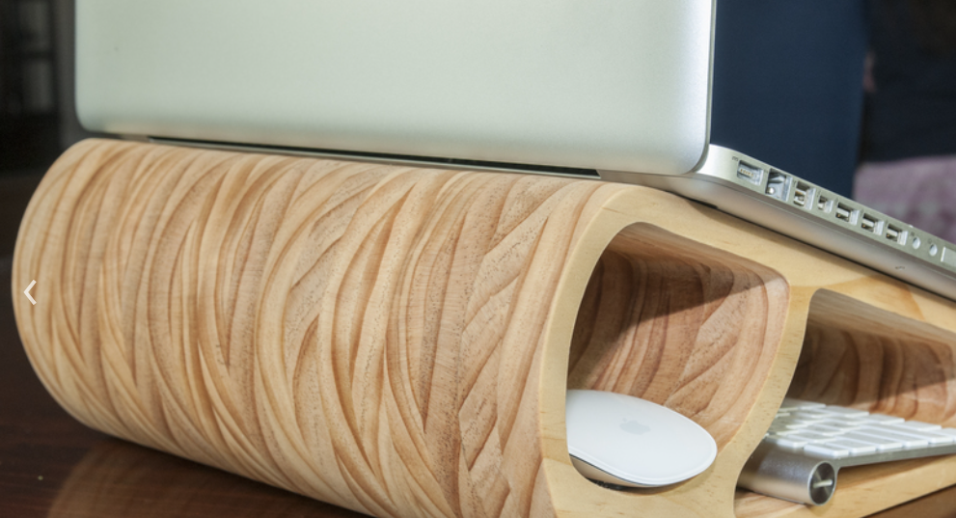
Project Suggestion…

Slide 9
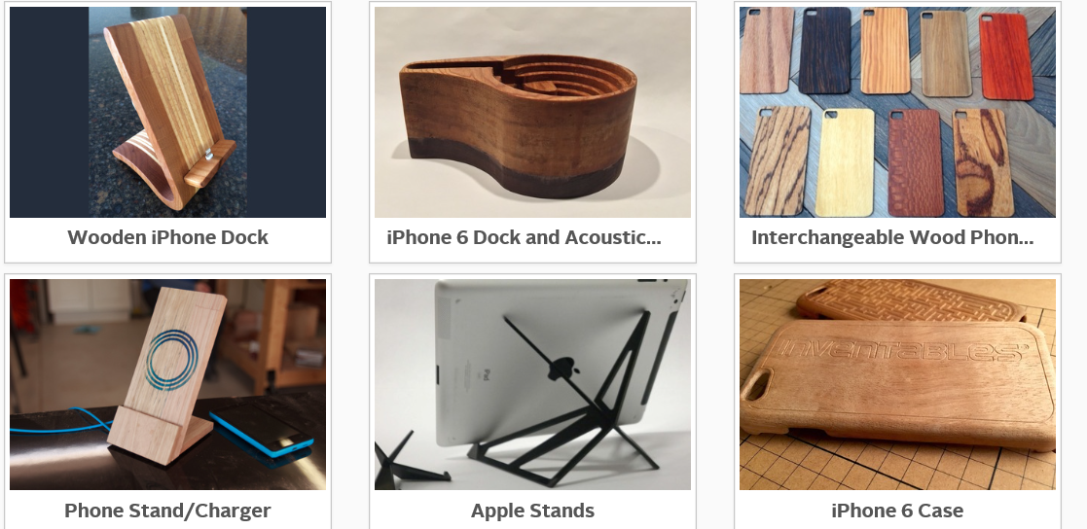
Project Suggestion…

Slide 10
Help yourself
Free tea and coffee is available at the bar

